Slide 1


PowerShell Workshop
Getting started
Jeffrey Snover
Jason Helmick
Technical Fellow/Microsoft
Author/Pluralsight
@JSnover
@theJasonHelmick

Slide 2
Course Topics
Getting Started with PowerShell
01 | Don’t fear the shell | 06 | The pipeline : Deeper
02 | The Help system | 07 | The Power in the Shell - Remoting
03 | The pipeline : Getting connected | 08 | Getting prepared for automation
04 | Extending the shell | 09 | Automation in scale - Remoting
05 | Objects for the Admin | 10 | Introducing scripting and toolmaking

Slide 3
01 | Don’t fear the shell
Jeffrey Snover | Distinguished Engineer & Lead Architect
Jason Helmick | Senior Technologist, Concentrated Technology

Slide 4
Infrastructure From Code: The Release Pipeline
Jason Helmick
Author/Evangelist
@theJasonHelmick www.JasonHelmick.com

Slide 5
Module Overview
The purpose for PowerShell
Installing PowerShell – Windows Management Framework
Launching PowerShell for the administrator
Customize the shell for comfort
Getting familiar with the shell

Slide 6



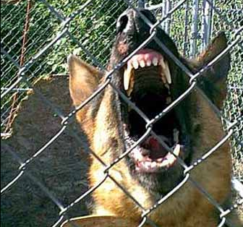
The Purpose to PowerShell
YOU
THEM
YOU
YOU
YOU
Improved management and automation
Manage real-time
Manage large scale

Slide 7
Installing PowerShell – Windows Management Framework
PowerShell V3 – Windows 8 and Server 2012
PowerShell V2 – Windows 7 and Server 2008
Download the Windows Management Framework 3.0 at
http://www.microsoft.com/en-us/download/details.aspx?id=34595
Windows XP and Server 2003 can run V2

Slide 8
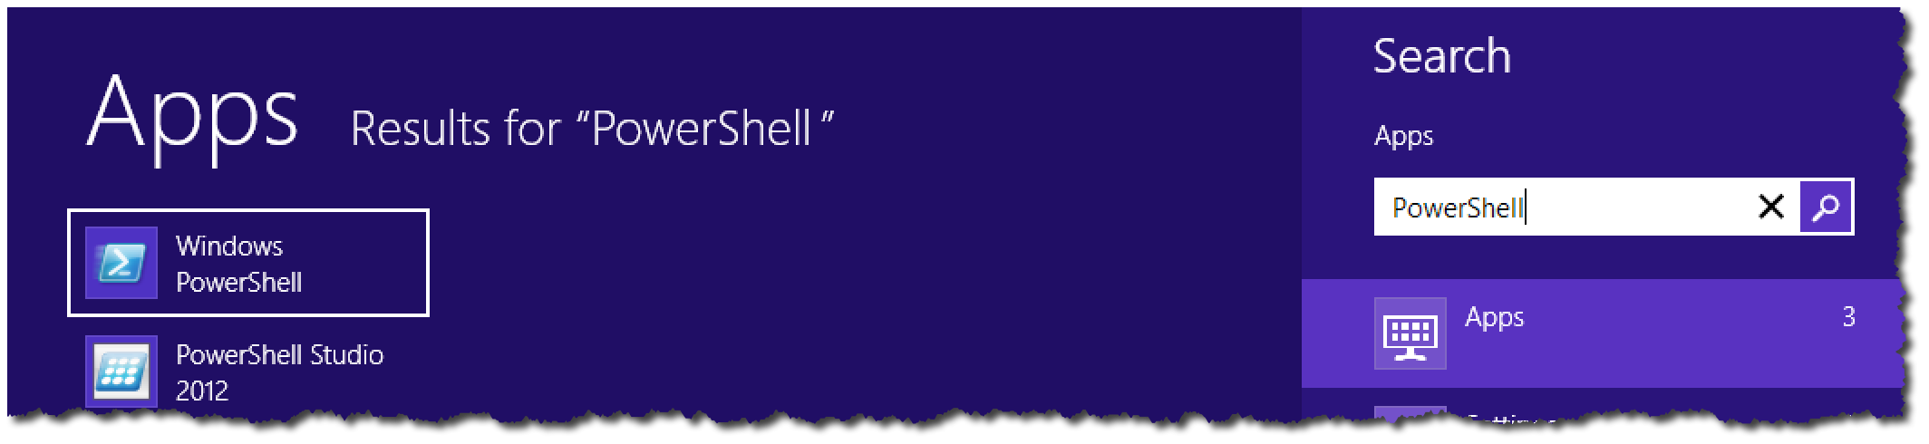

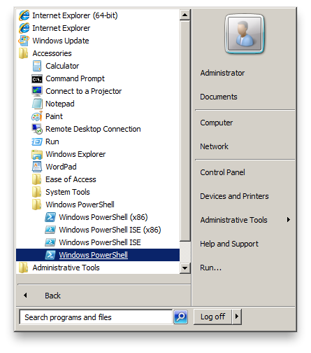
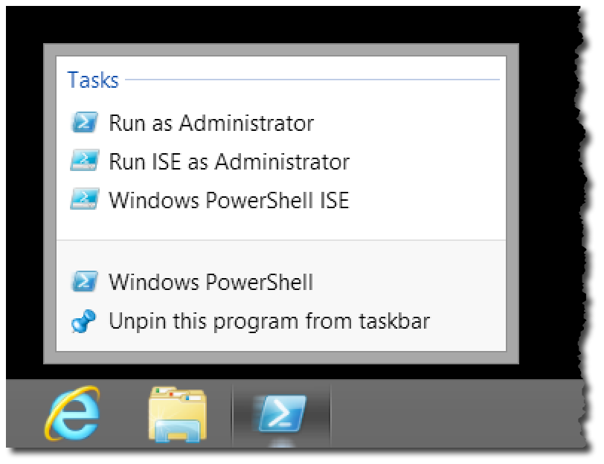
Launching PowerShell for the Administrator

Slide 9
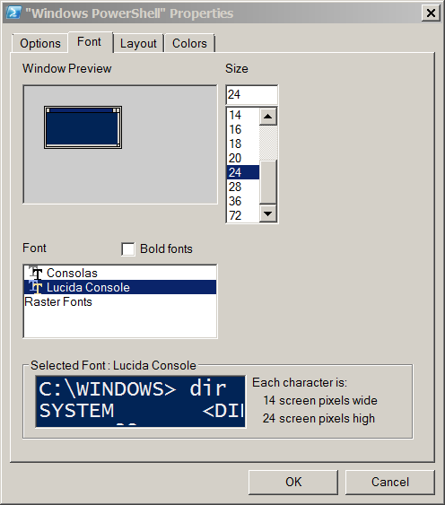
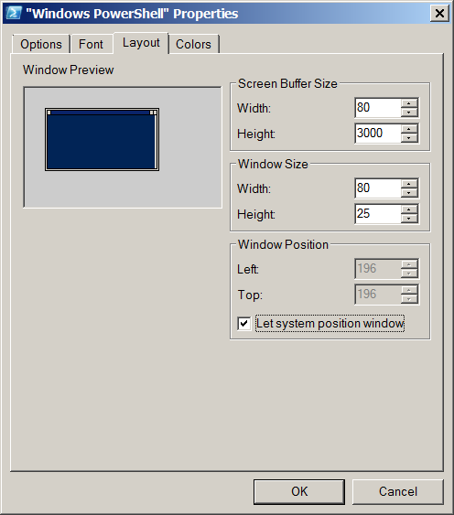
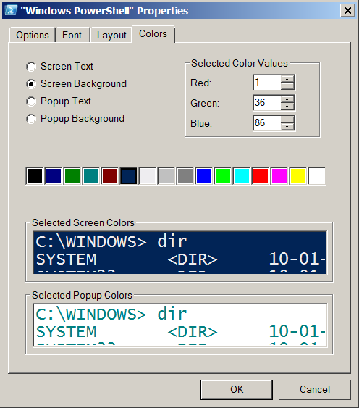
Customize the shell for comfort

Slide 10

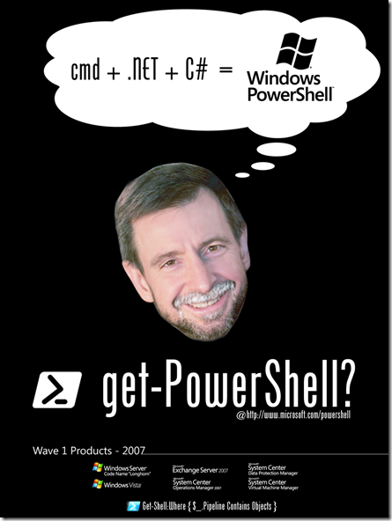
Getting familiar with the shell
Cmdlets : Verb – Noun
Native commands work!
Examples – Ping, IPConfig, calc, notepad, mspaint
cls - Clear-Host
cd - Set-Location
dir, ls - Get-Childitem
type, cat - Get-Content
Copy, cp - Copy-item

Slide 11
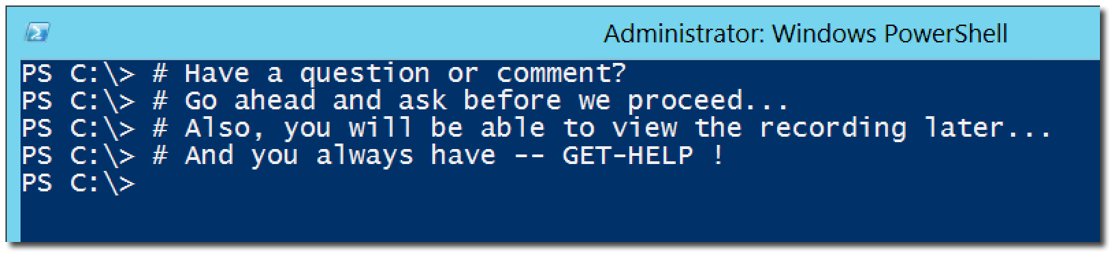
Questions or comments?

Slide 12
02 | The Help system
Jeffrey Snover | Distinguished Engineer & Lead Architect
Jason Helmick | Senior Technologist, Concentrated Technology

Slide 13
Module Overview
Why you need help
Updatable Help
Discoverability with the Help system
Understanding Syntax
Real-World using Help

Slide 14
Why you need help
Vast resource at your finger tips to help make you successful
Don’t memorize – Discover!
Thousands of cmdlets – all have help!
Scripting resources and information
Advanced PowerShell configuration information

Slide 15
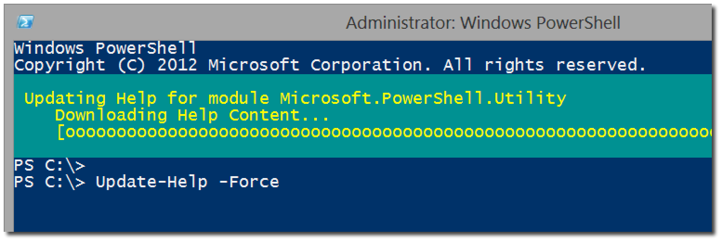
Updatable Help
Update to the latest version of Help
Save-Help to save to a local location

Slide 16
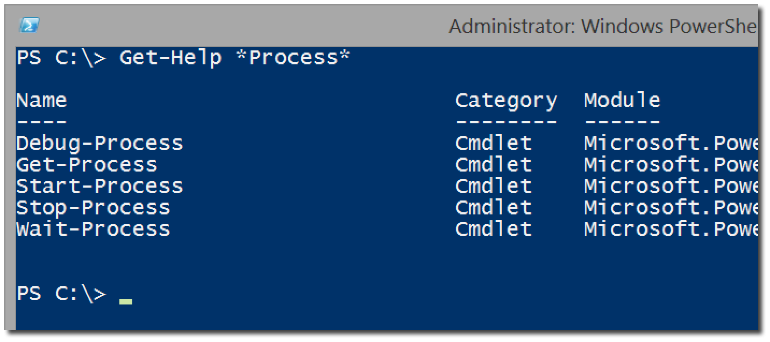
Discoverability with the Help system
Get-Help versus Help and Man
Help <cmdlet>
Help *partial*
Help <verb/noun>
Help <cmdlet> -Full
Help <cmdlet> -Online
Help <cmdlet> -ShowCommand
Get-Help About_*

Slide 17
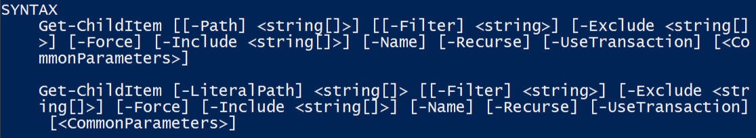
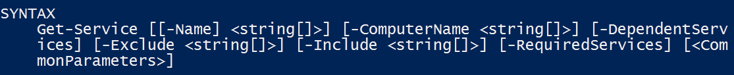
Understanding Syntax
Parameter sets
The meaning of Syntax
- Indicates A Parameter
[] Argument Accepts Multiple Values
[Param] is Positional
<> Indicates Arguments
[Param Arg] is Optional

Slide 18
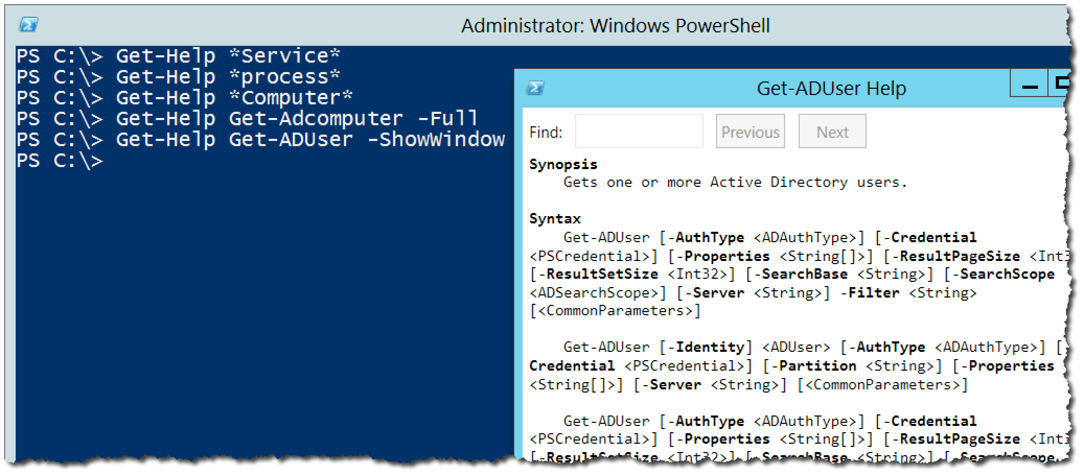
Real-World using Help

Slide 19
Questions or comments?

Slide 20
03 | The Pipeline : Getting Connected
Jeffrey Snover | Distinguished Engineer & Lead Architect
Jason Helmick | Senior Technologist, Concentrated Technology

Slide 21
Module Overview
What’s the pipeline and what does it do?
Exporting/Importing CSV
Exporting/Importing XML
Other files and printers
Displaying information in a GUI
Making a webpage of information
Cmdlets that kill

Slide 22
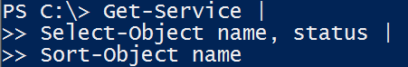
What’s the pipeline and what does it do?
Pipe character located above the Enter key
Connects cmdlets to produce better results
Can be broken into several lines to increase readability

Slide 23
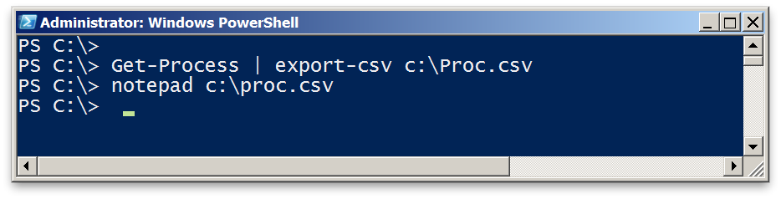
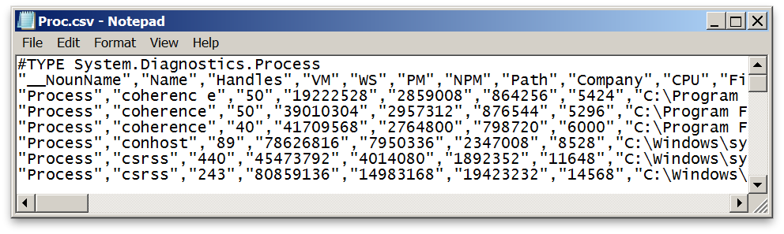
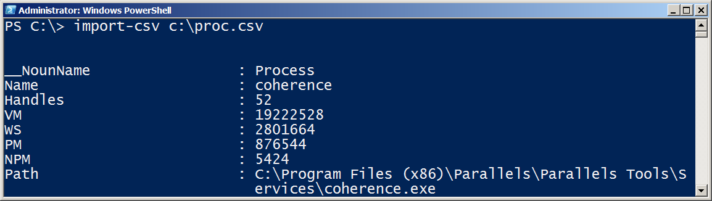
Exporting/Importing CSV

Slide 24
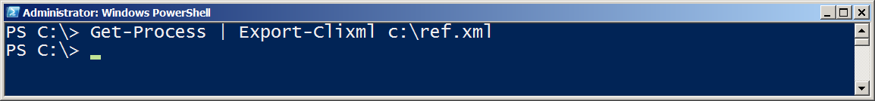
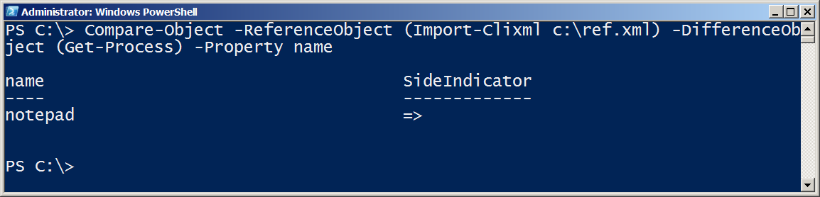
Exporting/Importing XML

Slide 25
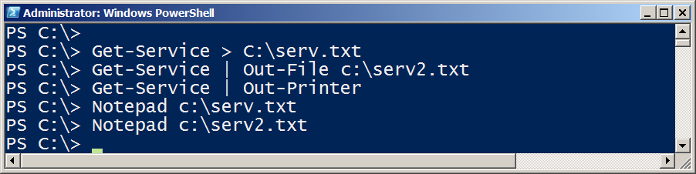
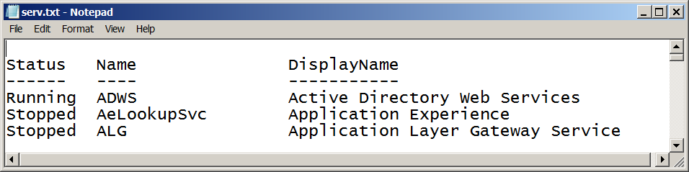

Other files and printers

Slide 26
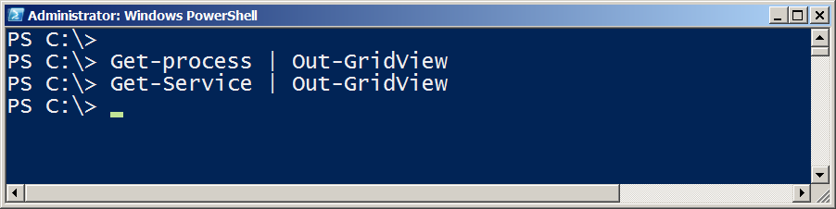
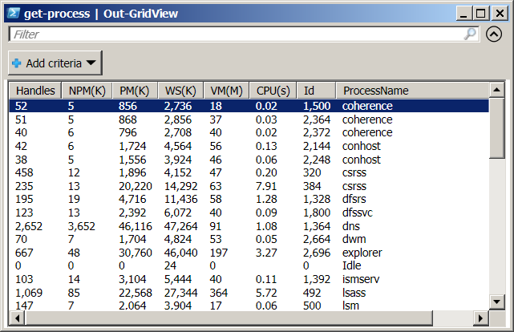
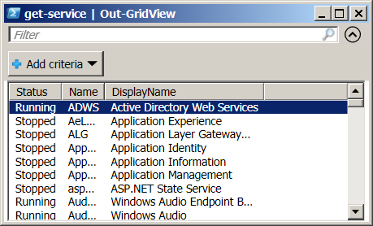
Displaying information in a GUI

Slide 27
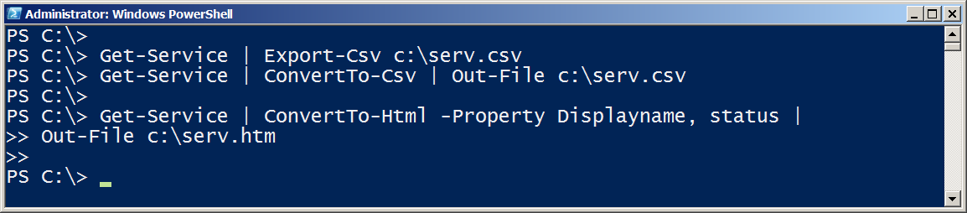
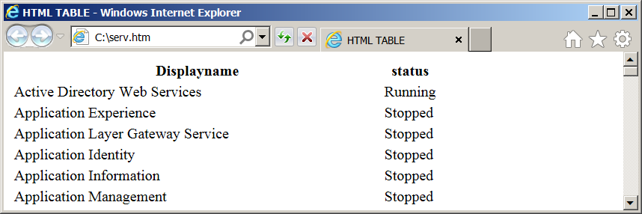
Making a webpage of information

Slide 28
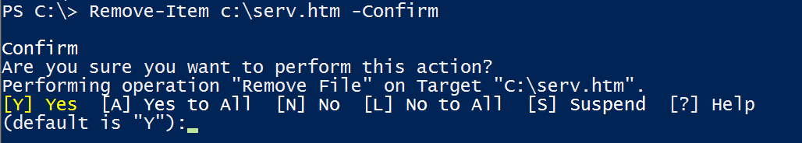
Cmdlets that kill
Stop-Process / kill
Stop-service
$ConfirmPreference
$WhatIfPreference
-Confirm
-Whatif

Slide 29
Questions or comments?

Slide 30
04 | Extending the Shell
Jeffrey Snover | Distinguished Engineer & Lead Architect
Jason Helmick | Senior Technologist, Concentrated Technology

Slide 31
Module Overview
Like the MMC – One Shell does it all
Finding and adding Snap-ins
Finding and adding Modules
Discovering new commands
The real world of cmdlets

Slide 32
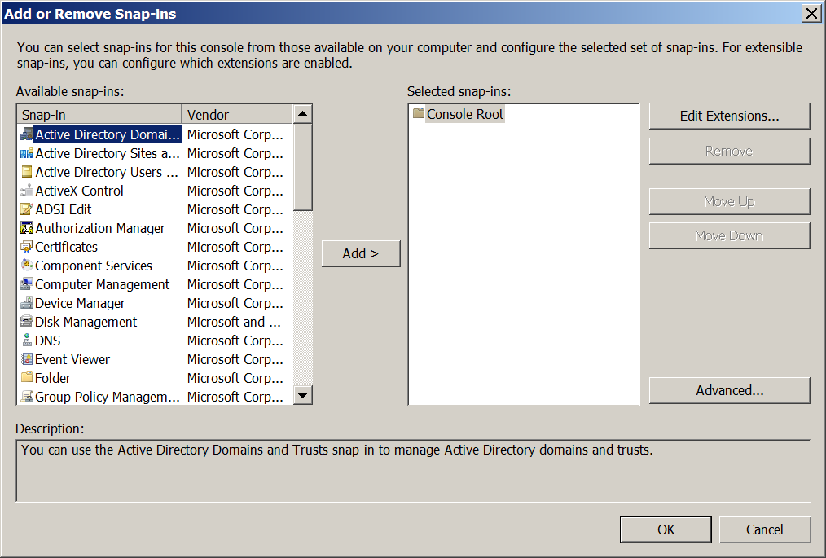
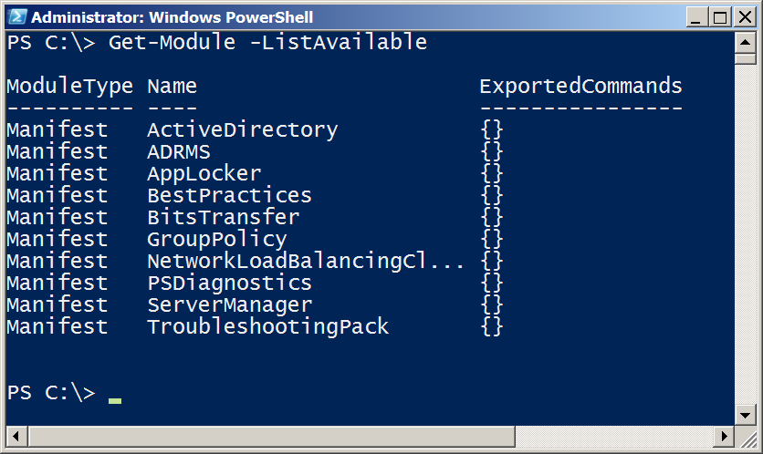
Like the MMC - One Shell does it all

Slide 33
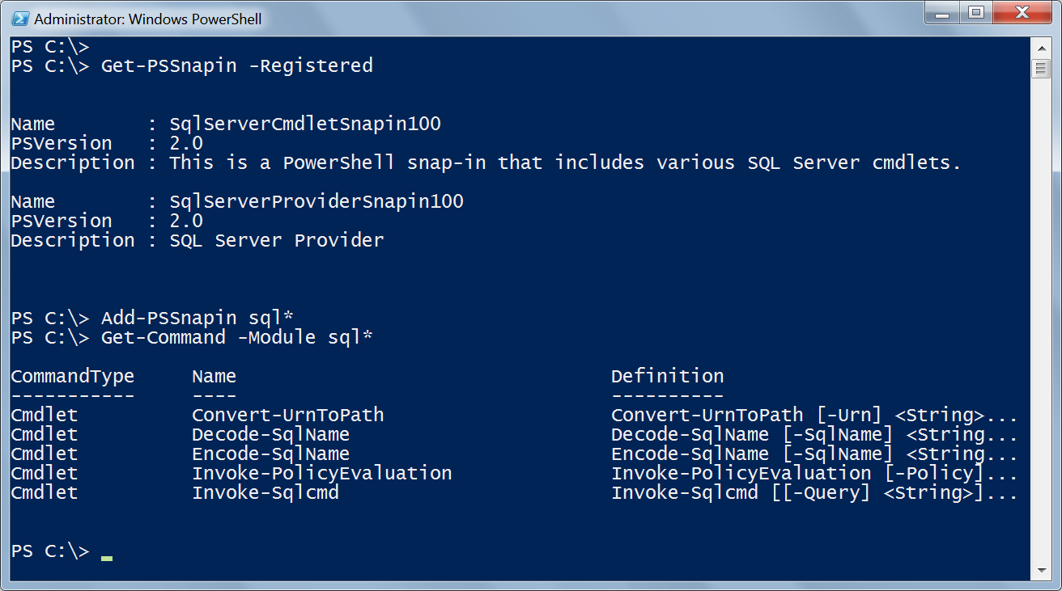

Finding & Adding Snap-ins

Slide 34
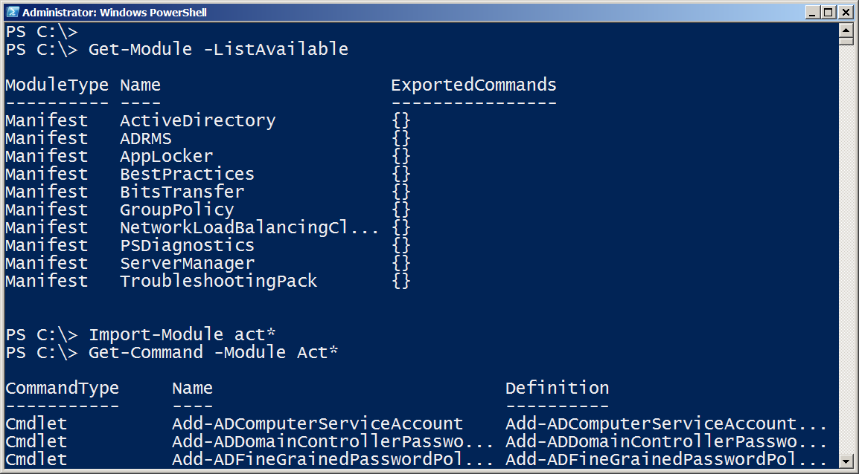
Finding & Adding Modules
PowerShell V3 dynamically imports modules when you use the cmdlet

Slide 35
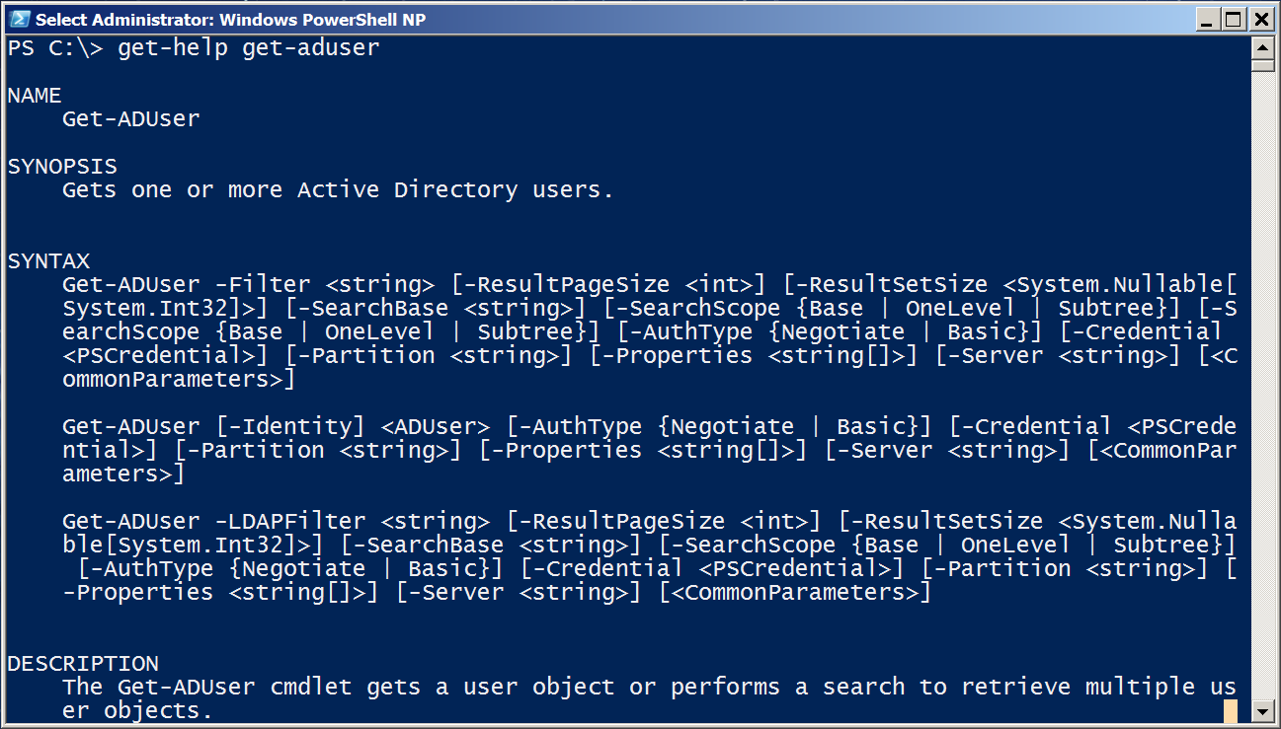
Discovering new commands

Slide 36
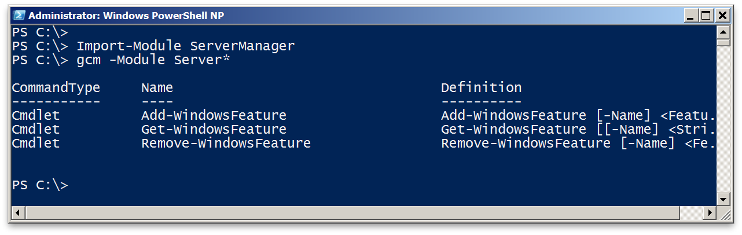
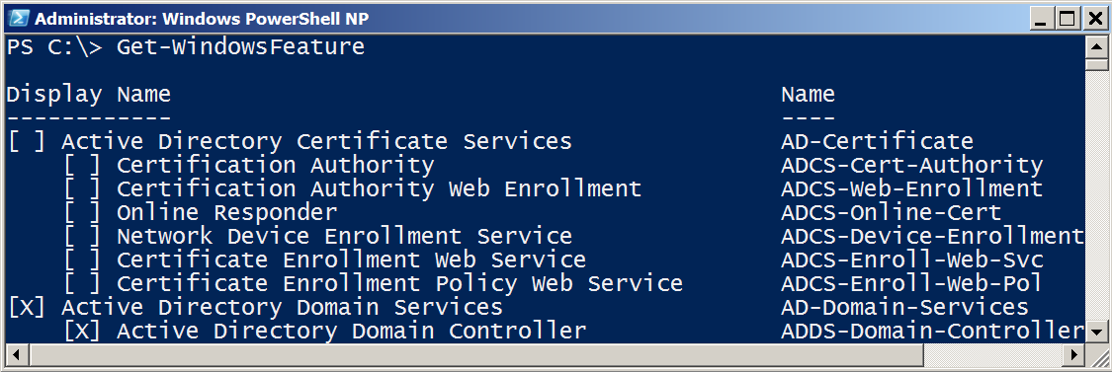
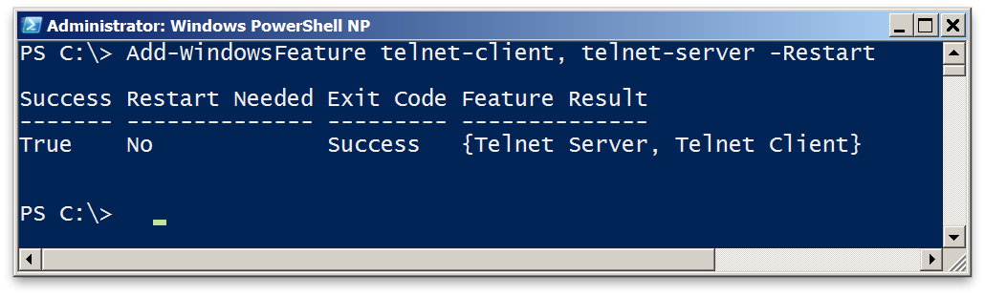
The real world of cmdlets

Slide 37
Questions or comments?

Slide 38
05 | Object for the Admin
Jeffrey Snover | Distinguished Engineer & Lead Architect
Jason Helmick | Senior Technologist, Concentrated Technology

Slide 39
Module Overview
Object across the pipeline
Getting the information you need
Sorting Objects
Selecting Objects
Custom Properties
Filtering data
Methods – When no cmdlet exists

Slide 40
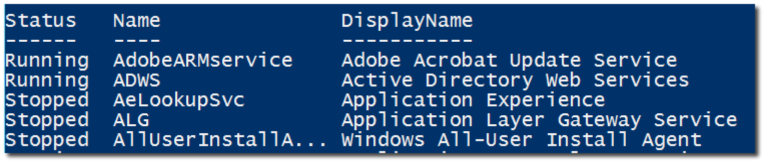
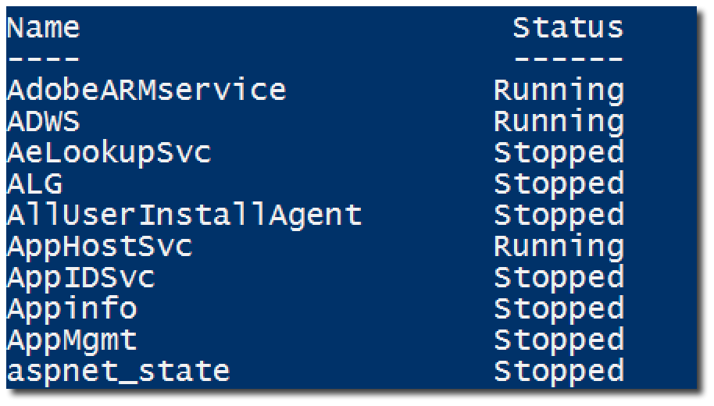
Object across the pipeline

Slide 41
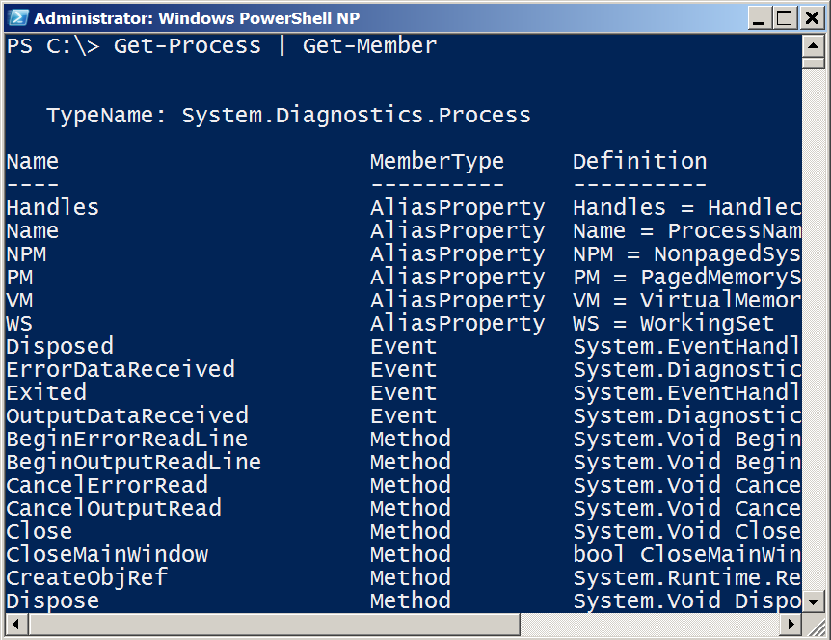
Getting the information you need
Get-Member (gm)
TypeName is a unique Windows assigned name
Displays the properties and methods of an object
Properties are potential columns of information
Methods are the potential actions that can be taken

Slide 42
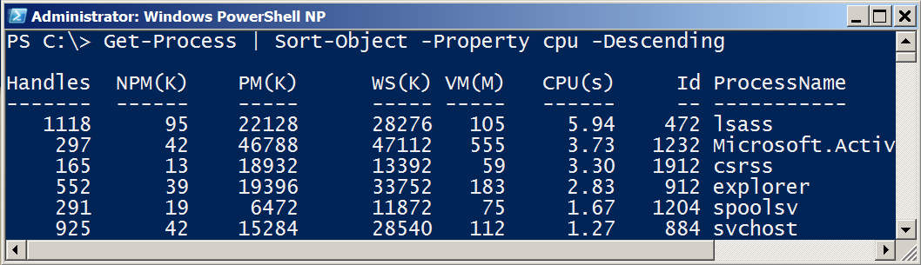
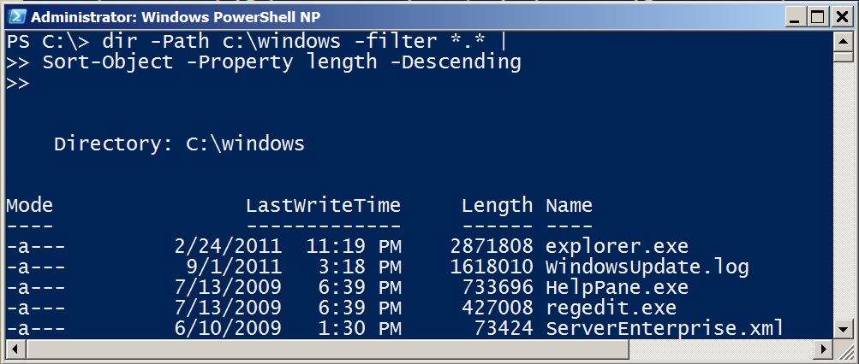
Sorting Objects
Sort-Object sorts properties.
Use Get-Member to see a list of properties

Slide 43
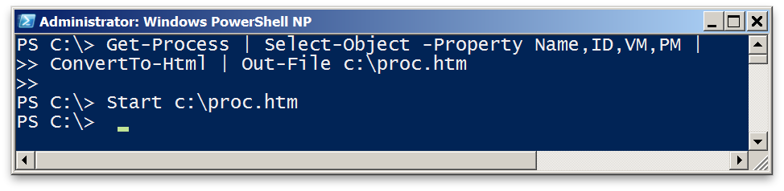
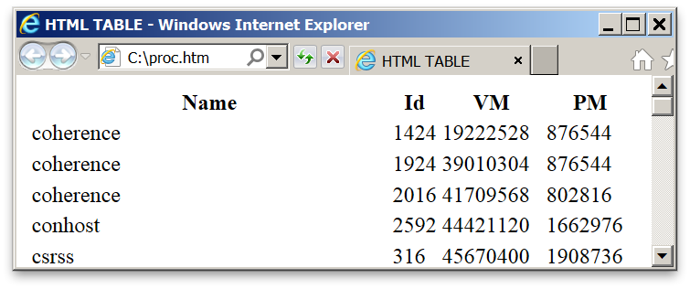
Selecting Objects
Select-Object selects properties.
Use Get-Member to list properties to select from.
-first and -last restrict list of rows displayed.

Slide 44
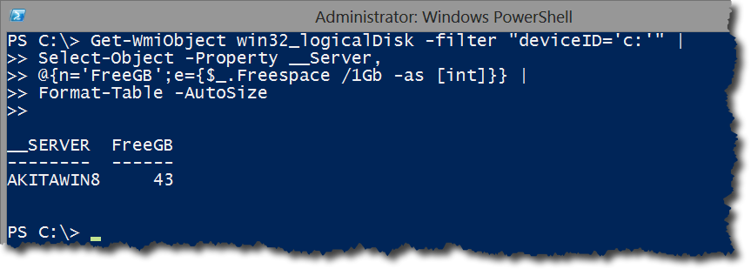
Custom Properties

Slide 45
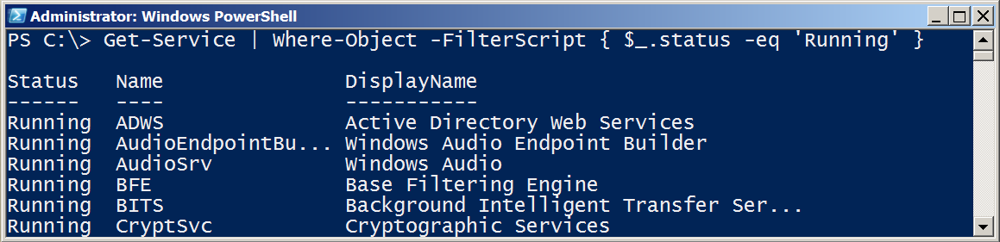
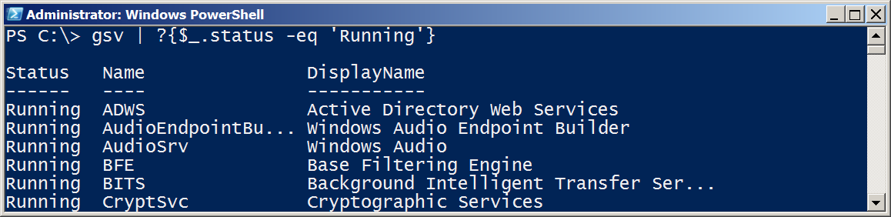
Filter Object Out of the Pipeline

Slide 46
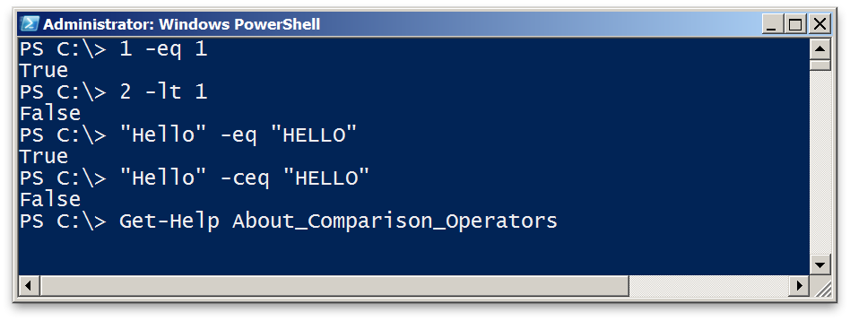
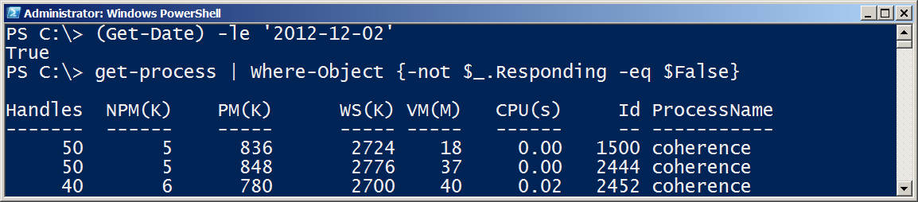
Comparison Operators
Comparison returns boolean True or False
Comparison can be case-sensitive using ‘c’ prefix
For complete description, see About_Comparison

Slide 47
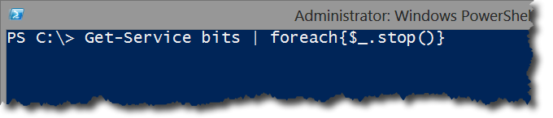
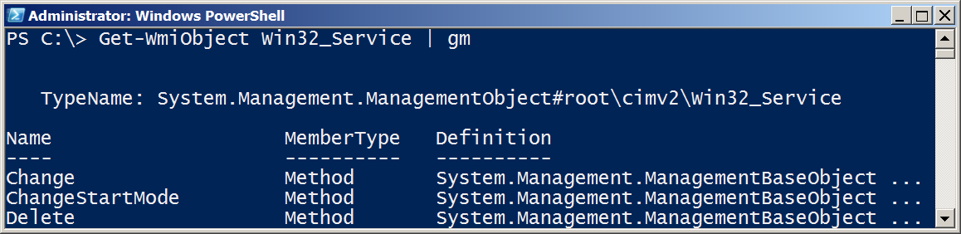


Methods – When no cmdlet exists

Slide 48
Questions or comments?

Slide 49
06 | The Pipeline : Deeper
Jeffrey Snover | Distinguished Engineer & Lead Architect
Jason Helmick | Senior Technologist, Concentrated Technology

Slide 50
Module Overview
How the pipeline really works - The 4 step solution
ByValue
ByPropertyName
What if my property doesn’t match – Customize it!
The Parenthetical – when all else fails

Slide 51
How the pipeline really works - The 4 step solution

Slide 52



ByValue
1. Get-Service passes ServiceController objects to the pipeline
2. Does Stop-Service accept ServiceController Objects?
3. Help Stop-Service -Full
displays a parameter that accepts ServiceController ByValue

Slide 53








ByPropertyName

Slide 54




ByPropertyName
1. Get-Process is passing a “Process” Object
2. Stop-Service does not support accepting “Process” objects ByValue, so PowerShell checks what can be accepted ByPropertyName.
3. -Name does accept strings ByPropertyName, and the objects in the pipeline are labeled as a Name property
4. Stop-Service attempts to use the objects for its -Name, in this example, fails

Slide 55


What if my property doesn’t match – Customize it!

Slide 56



The Parenthetical – when all else fails
1. I want to pass a list of computer names to Get-Service. Why does this fail?
2. -Name and -InputObject accept pipeline input ByValue, not -Computername. -Name accepts text, and then causes the failure.
Parenthesis don’t rely on binding and attach information directly to the desired parameter.

Slide 57






The Parenthetical – when all else fails
Returns a collection (table)
of objects.
Returns string contents

Slide 58
Questions or comments?

Slide 59
07 | The Power in the Shell - Remoting
Jeffrey Snover | Distinguished Engineer & Lead Architect
Jason Helmick | Senior Technologist, Concentrated Technology

Slide 60
Module Overview
Overview of Remoting
Enable Remoting
One-To-One
One-To-Many
Not the end yet!

Slide 61











Overview of Remoting

Slide 62



Enable Remoting
PowerShell Remoting is already enabled in Server 2012
Computer Configuration/Policies/Administrative Templates/Windows Components/Windows Remote Management

Slide 63

One to One - Interactive

Slide 64


One-To-Many

Slide 65

PowerShell Web Access
PowerShell – Anywhere, anytime, on any device!
Install-WindowsFeature –Name WindowsPowerShellWebAccess
Get-Help *Pswa*
Install-PswaWebApplication –UseTestCertificate
# Use the –useTestCertificate for testing (Expires in 90 days)
Add-PswaAuthorizationRule –userName <Domain\User | Computer\user> -ComputerName <Computer> -ConfigurationName AdminsOnly

Slide 66
Not the end yet!
More to come!
Managing in scale and in real time!
Automation and scripting!
Great resource: Free!
Secrets of PowerShell Remoting – Don Jones and Tobias Weltner
http://powershell.org/wp/powershell-books/

Slide 67
Questions or comments?

Slide 68
08 | Getting prepared for automation
Jeffrey Snover | Distinguished Engineer & Lead Architect
Jason Helmick | Senior Technologist, Concentrated Technology

Slide 69
Module Overview
PowerShell security goals
Execution Policy
Variables : a place to store stuff
Fun with Quotes
Getting and displaying input
Other output for scripts and automation

Slide 70


PowerShell security goals
Secured by default
Prevents mistakes by unintentional admins and users
No Script Execution
.Ps1 associated with notepad
Must type path to execute a script

Slide 71


Execution Policy
By default, PowerShell does not run scripts.
Get/Set-ExecutionPolicy
Restricted
Unrestricted
AllSigned
RemoteSigned
Bypass
Undefined
Can be set with Group Policy

Slide 72




Variables: A place to store stuff
Use $ to create and use variables
Can contain letters, numbers, spaces and underscores
Don’t persist after Shell exits
New-Variable
Set-Variable
Get-Variable
Clear-Variable
Remove-Variable
Can force a type – [int]$var
Note: The $ is not part of the variable name, it’s a cue to access the contents of the variable

Slide 73

Fun with Quotes
Double Quotes resolve all variables
Can use Sub-Expressions
Single Quotes prevent substitution
Get-Help About_Quoting_Rules
Back-tick/Grave-Accent prevents individual substitution

Slide 74



Getting and displaying input

Slide 75

Other output for scripts and automation
Write-Warning
Write-Verbose
Write-Debug
Write-Error
$Preference variables to know
Help about_Preference_Variables
$DebugPreference=SilentlyContinue
$ErrorActionPreference=Continue
#VerbosePreference=SilentlyContinue

Slide 76
Questions or comments?

Slide 77
09 | Automation in scale - Remoting
Jeffrey Snover | Distinguished Engineer & Lead Architect
Jason Helmick | Senior Technologist, Concentrated Technology

Slide 78
Module Overview
Reusable Sessions
Sessions with Invoke-Command
Real-world deployment of a website
Getting commands from anywhere

Slide 79


Reusable Sessions
Can be disconnected and reconnected in PowerShell V3

Slide 80


Sessions with Invoke-Command

Slide 81
Real-world deployment of a website
Demonstration

Slide 82

Getting commands from anywhere - Implicit Remoting

Slide 83
Questions or comments?

Slide 84
10 | Introducing scripting and toolmaking
Jeffrey Snover | Distinguished Engineer & Lead Architect
Jason Helmick | Senior Technologist, Concentrated Technology

Slide 85
Module Overview
The new ISE
Making commands repeatable
Adding parameters to your script
Documenting your script
Turning your script into a tool for others
Storing your tools in a module

Slide 86


The new ISE

Slide 87
Making commands repeatable

Slide 88

Adding parameters to your script

Slide 89

Documenting your script

Slide 90

Turning your script into a tool for others

Slide 91

Storing your tools in a module

Slide 92
Questions or comments?

